Slide 1


Q: How to be a WINNER and
not to be a DISGRACE to you family?

Slide 2
Early Game Strategy -
“Win Conditions” in First 10 Min
GZS (summoner ID)

Slide 3
What is League of Legends?
Online 5v5 game
Each player control a “champion”
Champions level up with experiences - from level 1 to level 18
Earn gold -
Take down enemy champions, structures, and minions
Take down neutral jungle camps and epic monsters
Use gold to buy item and get stronger
Ultimate goal is to destroy the enemy base!
Usual game time 15 - 40 mins

Slide 4
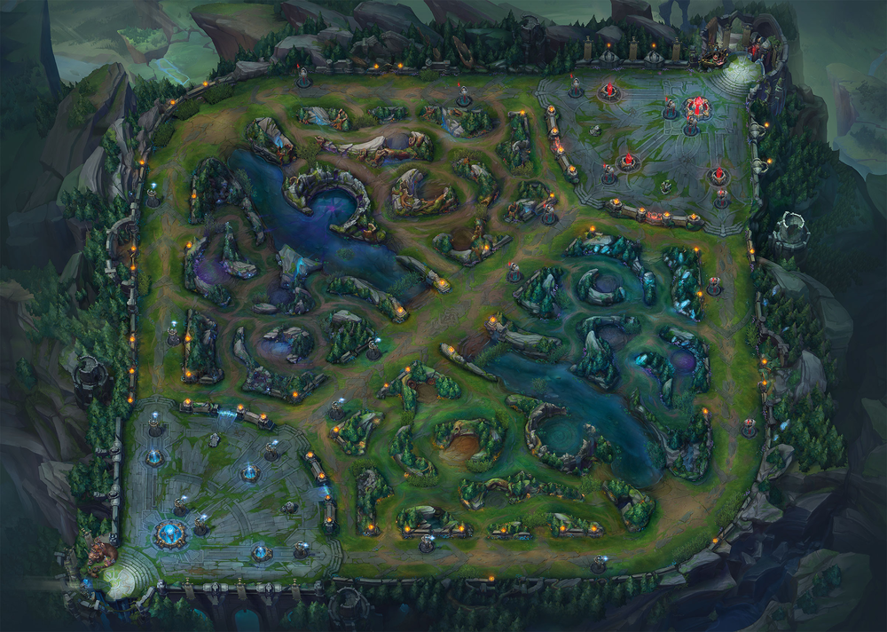

Slide 5
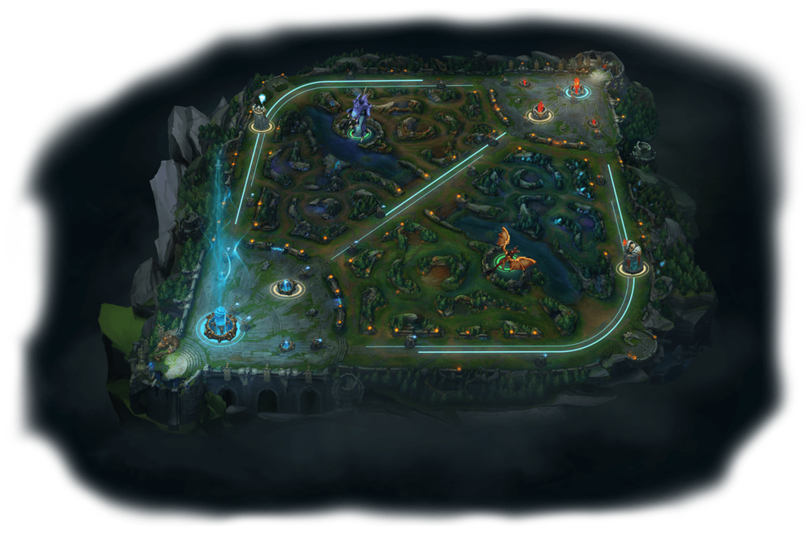
Map

Slide 6
Map
The Base

Slide 7
Map
The Tower

Slide 8
The Jungles

Slide 9
Map
The Goal

Slide 10
The Data Set The Approach
Diamond Rank Games
Top 2.3% of the playerbase
*Not me*
~ 10k games
40 variables
Clean!
75% Training, 25% Testing
Machine - Random Forest
Testing error
Human - Tools
PCA
Classification Tree
“Manual” Logistic Regression
Compare
Explore on important predictors

Slide 11
First look -
> data.raw <- data
> print(colnames(data.raw))
[1] "gameId" "blueWins" "blueWardsPlaced" "blueWardsDestroyed"
[5] "blueFirstBlood" "blueKills" "blueDeaths" "blueAssists"
[9] "blueEliteMonsters" "blueDragons" "blueHeralds" "blueTowersDestroyed"
[13] "blueTotalGold" "blueAvgLevel" "blueTotalExperience" "blueTotalMinionsKilled"
[17] "blueTotalJungleMinionsKilled" "blueGoldDiff" "blueExperienceDiff" "blueCSPerMin"
[21] "blueGoldPerMin" "redWardsPlaced" "redWardsDestroyed" "redFirstBlood"
[25] "redKills" "redDeaths" "redAssists" "redEliteMonsters"
[29] "redDragons" "redHeralds" "redTowersDestroyed" "redTotalGold"
[33] "redAvgLevel" "redTotalExperience" "redTotalMinionsKilled" "redTotalJungleMinionsKilled"
[37] "redGoldDiff" "redExperienceDiff" "redCSPerMin" "redGoldPerMin"
ggplot(data = data.raw, aes(x = factor(blueWins), fill = factor(blueFirstBlood))) + geom_bar(position = "fill") + ggtitle("First Blood's Effect on Winning")
ggplot(data = data.raw, aes(x = factor(blueWins), y = blueGoldDiff, fill = factor(blueWins))) + geom_violin(trim = TRUE) + geom_boxplot(width=0.3, fill="grey67") +
theme_classic() + ggtitle("Gold Difference at 10min vs Winning")
ggplot(data = data.raw, aes(x = factor(blueWins), y = blueWardsPlaced)) + geom_jitter(height = 0, width = 0.2, size = 0.9) + ggtitle("Amount of Wards Place vs Winning")

Slide 12
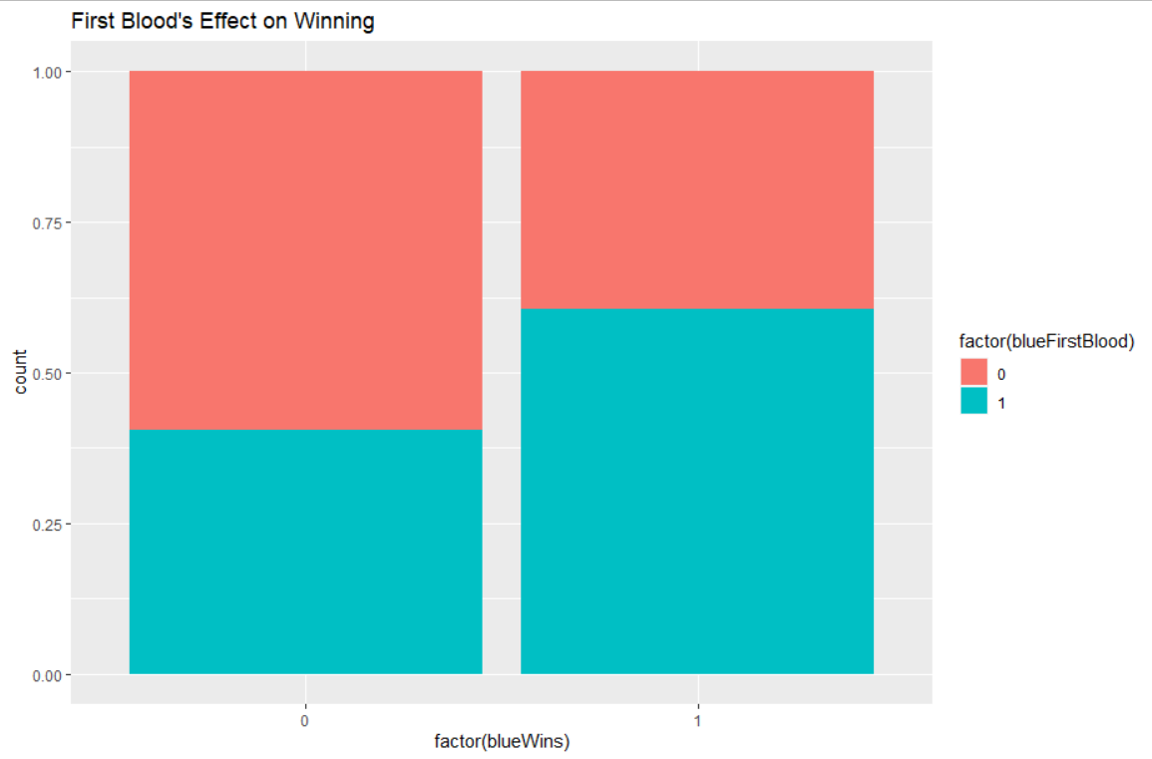
First look -

Slide 13
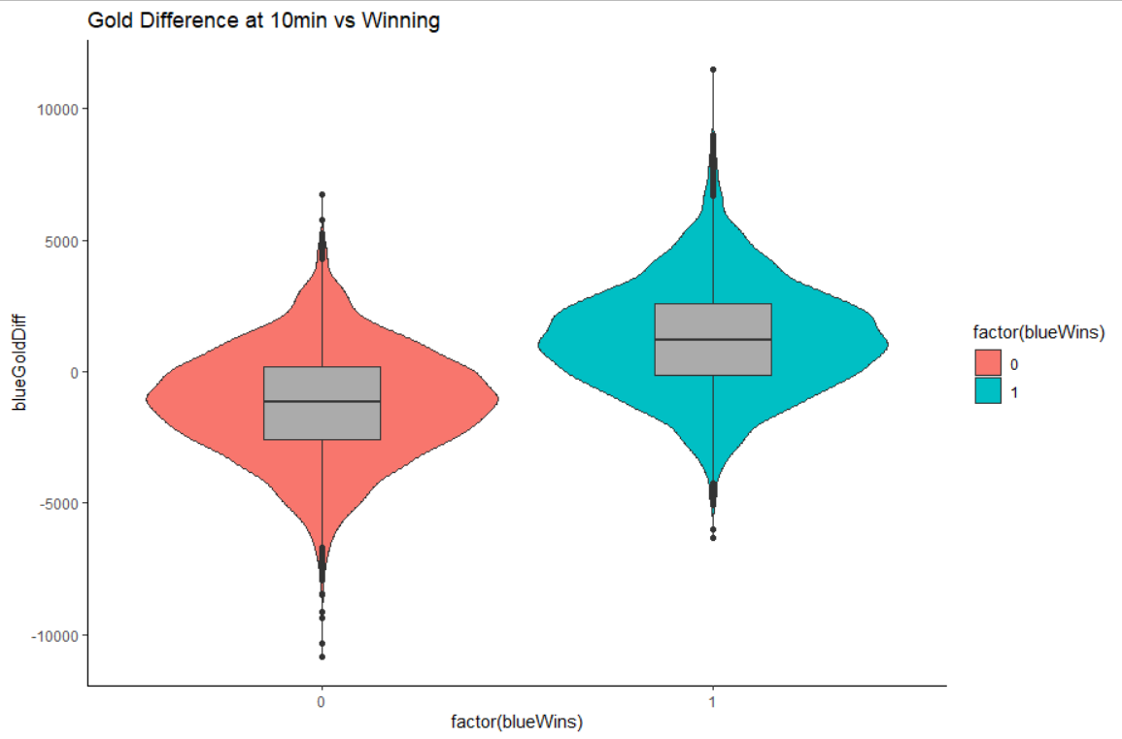
First look -

Slide 14
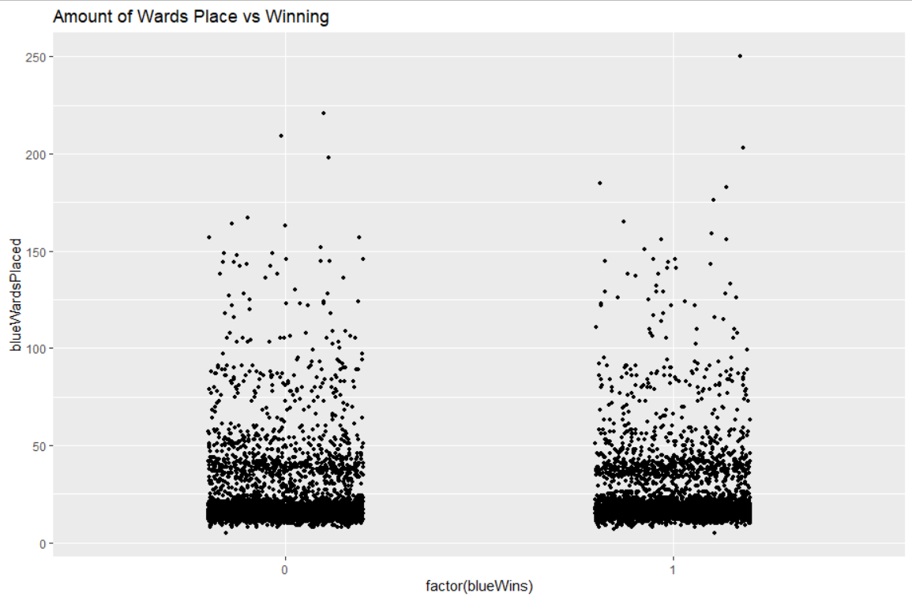
First look -

Slide 15
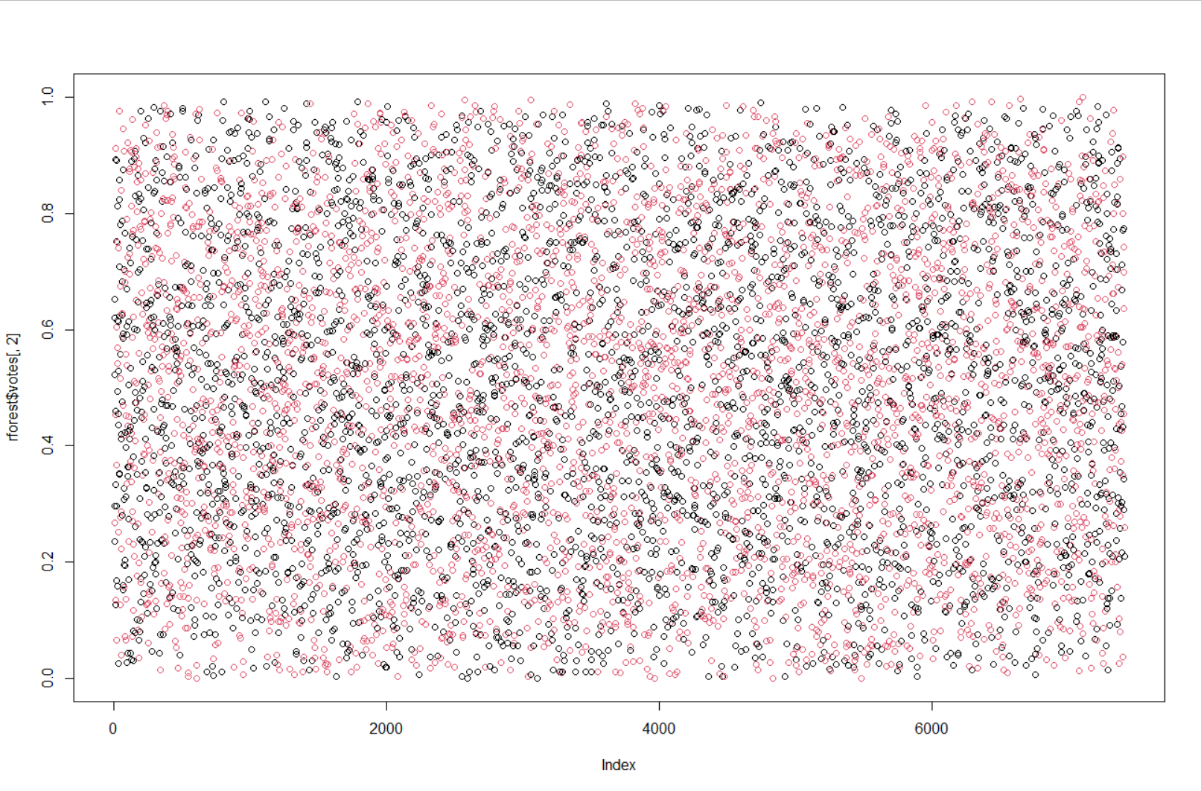
Random Forest
> rforest = randomForest(data = data.raw.train, blueWins ~ ., ntree = 1000)
> rforest$confusion
0 1 class.error
0 2712 1011 0.2715552
1 1001 2685 0.2715681
> table(actual = data.raw.test$blueWins , predicted = rforest.test)
predicted
actual 0 1
0 916 339
1 304 911

Slide 16
Random Forest
> importance(rforest)
MeanDecreaseGini
gameId 128.052925
blueWardsPlaced 91.918187
blueWardsDestroyed 63.630292
blueFirstBlood 14.699162
blueKills 53.148225
blueDeaths 56.447008
blueAssists 75.836914
blueEliteMonsters 24.374069
blueDragons 23.519550
blueHeralds 12.671823
blueTowersDestroyed 3.761221
blueTotalGold 158.532104
blueAvgLevel 54.223737
blueTotalExperience 152.005257
blueTotalMinionsKilled 97.544271
blueTotalJungleMinionsKilled 95.109818
blueGoldDiff 315.577223
blueExperienceDiff 245.293830
blueCSPerMin 97.421253
blueGoldPerMin 166.897328
redWardsPlaced 87.295361
redWardsDestroyed 62.997377
redFirstBlood 14.738202
redKills 60.327120
redDeaths 52.852527
redAssists 73.096563
redEliteMonsters 26.367887
redDragons 20.625040
redHeralds 11.178615
redTowersDestroyed 3.469123
redTotalGold 163.425938
redAvgLevel 52.346715
redTotalExperience 138.909896
redTotalMinionsKilled 97.084911
redTotalJungleMinionsKilled 94.797917
redGoldDiff 319.938749
redExperienceDiff 243.332952
redCSPerMin 97.019894
redGoldPerMin 153.405964

Slide 17
Random Forest
> importance(rforest)
MeanDecreaseGini
gameId 128.052925 ????
blueWardsPlaced 91.918187
blueWardsDestroyed 63.630292
blueFirstBlood 14.699162
blueKills 53.148225
blueDeaths 56.447008
blueAssists 75.836914
blueEliteMonsters 24.374069
blueDragons 23.519550
blueHeralds 12.671823
blueTowersDestroyed 3.761221
blueTotalGold 158.532104
blueAvgLevel 54.223737
blueTotalExperience 152.005257
blueTotalMinionsKilled 97.544271
blueTotalJungleMinionsKilled 95.109818
blueGoldDiff 315.577223
blueExperienceDiff 245.293830
blueCSPerMin 97.421253
blueGoldPerMin 166.897328
redWardsPlaced 87.295361
redWardsDestroyed 62.997377
redFirstBlood 14.738202
redKills 60.327120
redDeaths 52.852527
redAssists 73.096563
redEliteMonsters 26.367887
redDragons 20.625040
redHeralds 11.178615
redTowersDestroyed 3.469123
redTotalGold 163.425938
redAvgLevel 52.346715
redTotalExperience 138.909896
redTotalMinionsKilled 97.084911
redTotalJungleMinionsKilled 94.797917
redGoldDiff 319.938749
redExperienceDiff 243.332952
redCSPerMin 97.019894
redGoldPerMin 153.405964

Slide 18
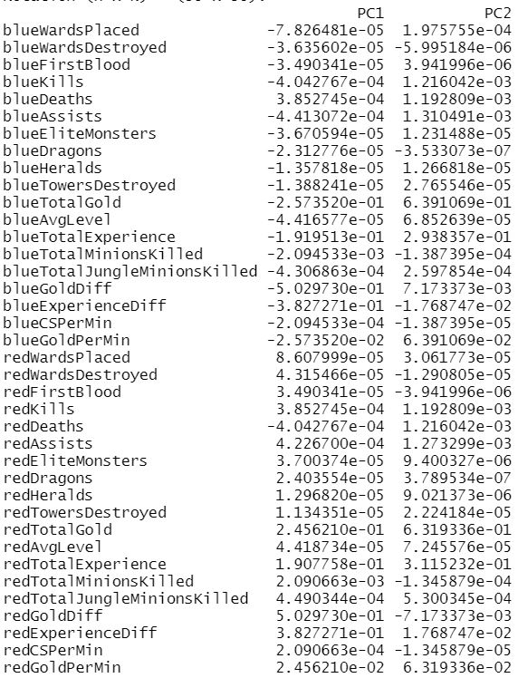
Principal Component Analysis

Slide 19
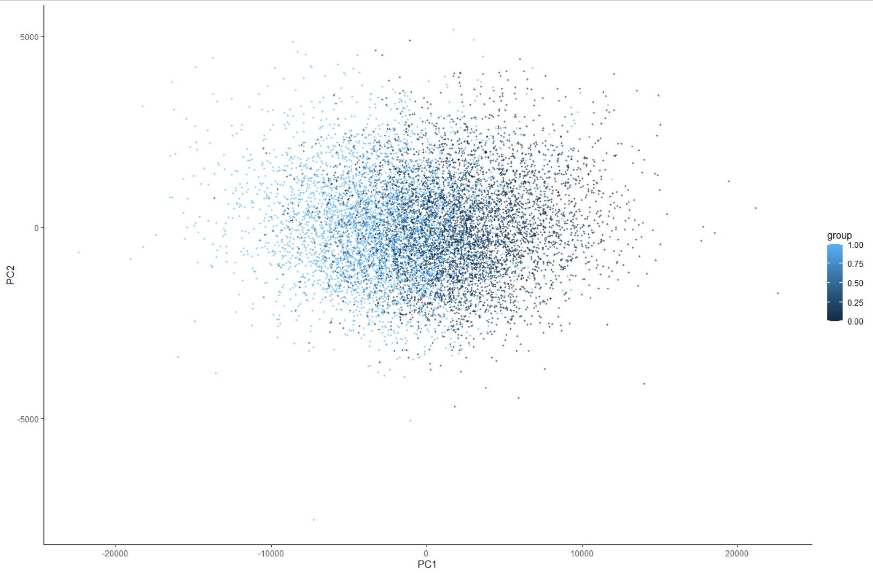
Principal Component Analysis

Slide 20
Classification Tree
> trained_tree <- rpart(blueWins ~ ., method = 'class', data = data.train, control=rpart.control(cp=0.00145))
> summary(trained_tree)
Call:
rpart(formula = blueWins ~ ., data = data.train, method = "class",
control = rpart.control(cp = 0.00145))
n= 7409
CP nsplit rel error xerror xstd
1 0.444775311 0 1.0000000 1.0259881 0.01164762
2 0.002977802 1 0.5552247 0.5617217 0.01046306
3 0.001488901 5 0.5422306 0.5652409 0.01048299
4 0.001450000 7 0.5392528 0.5663238 0.01048908
Variable importance
blueGoldDiff blueKillDiff blueExperienceDiff blueMinionDiff firstBlood
32 23 21 12 7
blueEliteMonstersDiff
4

Slide 21
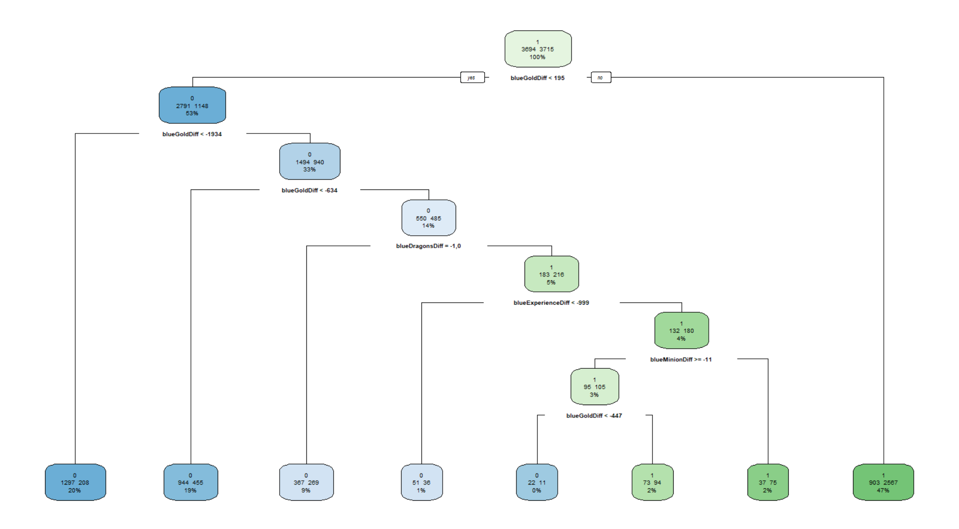
Classification Tree

Slide 22
Classification Tree
> trained_tree_train = predict(trained_tree, type ='class')
> table(actual = data.train$blueWins, predicted = trained_tree_train)
predicted
actual 0 1
0 2681 1013
1 979 2736
>
> trained_tree_test= predict(trained_tree, type='class', newdata = data.test)
> table(actual = data.test$blueWins, predicted = trained_tree_test)
predicted
actual 0 1
0 906 349
1 306 909
Random Forest:
predicted
actual 0 1
0 916 339
1 304 911

Slide 23
Logistic Regression
model1 <- glm(data = data.train, blueWins ~ blueGoldDiff + blueDragonsDiff + blueExperienceDiff + blueMinionDiff, family='binomial')
Coefficients:
Estimate Std. Error z value Pr(>|z|)
(Intercept) -2.733e-01 4.293e-02 -6.366 1.94e-10 ***
blueGoldDiff 4.328e-04 2.744e-05 15.768 < 2e-16 ***
blueDragonsDiff0 2.566e-01 7.143e-02 3.592 0.000328 ***
blueDragonsDiff1 6.127e-01 6.319e-02 9.696 < 2e-16 ***
blueExperienceDiff 2.096e-04 3.317e-05 6.320 2.62e-10 ***
blueMinionDiff -2.811e-03 1.165e-03 -2.413 0.015843 *
---
…...
predicted
actual 0 1
0 928 327
1 297 918
Random Forest:
predicted
actual 0 1
0 916 339
1 304 911

Slide 24
Side Question -
How to get more gold ?

Slide 25
Regression
lm(formula = blueGoldDiff ~ blueKillDiff + blueTowerDiff + blueMinionDiff + blueJungleDiff, data = data.train)
Residuals:
Min 1Q Median 3Q Max
-2621.99 -376.92 -4.34 381.64 2304.25
Coefficients:
Estimate Std. Error t value Pr(>|t|)
(Intercept) 24.4980 6.5988 3.712 0.000207 ***
blueKillDiff 438.8082 1.7691 248.034 < 2e-16 ***
blueTowerDiff 1068.2254 20.9658 50.951 < 2e-16 ***
blueMinionDiff 21.0999 0.2393 88.190 < 2e-16 ***
blueJungleDiff 22.2493 0.4638 47.976 < 2e-16 ***
---
Signif. codes: 0 ‘***’ 0.001 ‘**’ 0.01 ‘*’ 0.05 ‘.’ 0.1 ‘ ’ 1
Residual standard error: 566.3 on 7404 degrees of freedom
Multiple R-squared: 0.9466, Adjusted R-squared: 0.9465
F-statistic: 3.28e+04 on 4 and 7404 DF, p-value: < 2.2e-16
Typically...
1 kill = 450 gold
First blood = 500 gold
1 tower = 300 gold
First tower = 600 gold
Average minion = 20 gold
Average jungle = 20 gold

Slide 26
GG

